Slide 1
Project Team - Blue EDA Phase 1
Monisha Vellore Dayananda, Saloni Bhaiya,
Sejal Arora, & Jolie Breitbach

Slide 2




Agenda
Project Statement
Introduction
Data Description
Exploratory Data Analysis
Correlation Matrix
Machine Learning Models
Conclusion

Slide 3



Problem Statement
Customer churn is a major concern for banks
High churn rates lead to lost revenue and decreased customer loyalty
Banks need to identify the factors that contribute to churn and take proactive measures to retain customers
Monisha Vellore Dayananda

Slide 4



Introduction
Analyze the predictive power of customer demographic variables
Identify which variables are the strongest predictors of churn
By understanding the factors that contribute to churn, banks can take targeted actions to retain customers and increase revenue.
Monisha Vellore Dayananda

Slide 5


Data Description
Monisha Vellore Dayananda

Slide 6
Client Num
Attrition Flag
Customer Age
Gender
Dependent Count
Education Level
Marital Status
Income Category
Card Category
Months on Book
Total Relationship Count
Months Inactive 12 Month
Contacts Count 12 Month
Credit Limit
Total Revolving Balance
Avg Open To Buy
Total Amt Change Q4 Q1
Total Transaction Amount
Total Transaction Count
Total Count Change Q4 Q1
Avg Utilization Ratio
Monisha Vellore Dayananda

Slide 7
Monisha Vellore Dayananda
Income Category - Demographic variable - Annual Income Category of the account holder (< $40K, $40K - 60K, $60K - $80K, $80K-$120K, > $120K, Unknown)
Customer Age - Demographic variable - Customer's Age in Years
Sejal Arora
Total Transaction Count - Total number of transactions(last 12 months)
Total Relationship Count - Total number of products held by customer

Slide 8
Saloni Bhaiya
Credit Limit - Credit limit on customer’s credit card
Total Transaction Amount - Total transaction amount of the last 12 months
Jolie Breitbach
Average Utilization Ratio - Percentage of total credit limit used by the account holder
Months on Book - Period of customer’s relationship with bank, in months

Slide 9


Exploratory Data Analysis Goals
Monisha Vellore Dayananda

Slide 10
Exploratory Data Analysis Goals
The goal of exploratory data analysis (EDA) is to understand the main characteristics of the dataset
EDA helps to identify patterns, trends, and relationships in the data
We used EDA to explore the distributions of our predictor variables and the relationship between these variables and churn
EDA also helps to identify any outliers, missing values, or other issues with the data that need to be addressed before modeling.
Monisha Vellore Dayananda

Slide 11

Customer Age
Monisha Vellore Dayananda

Slide 12
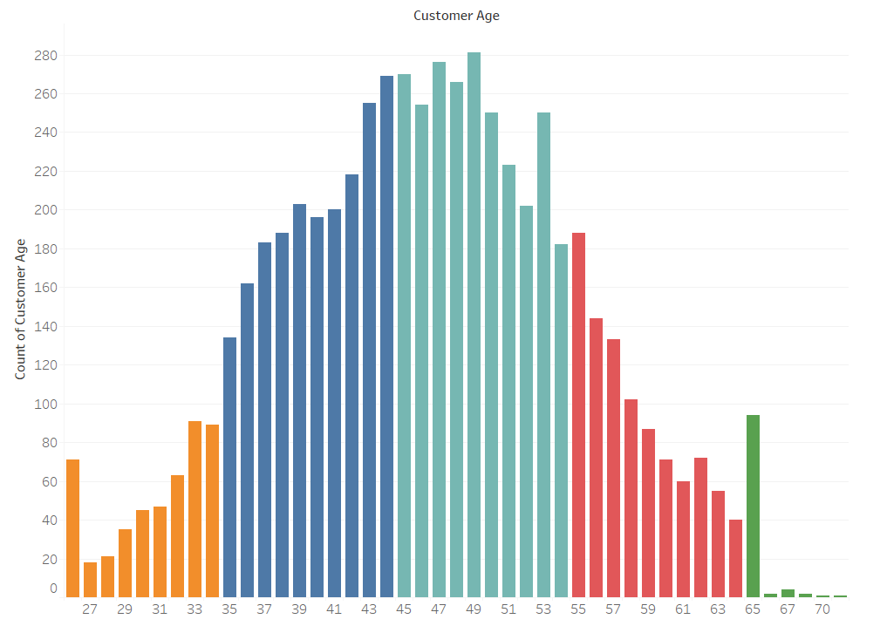
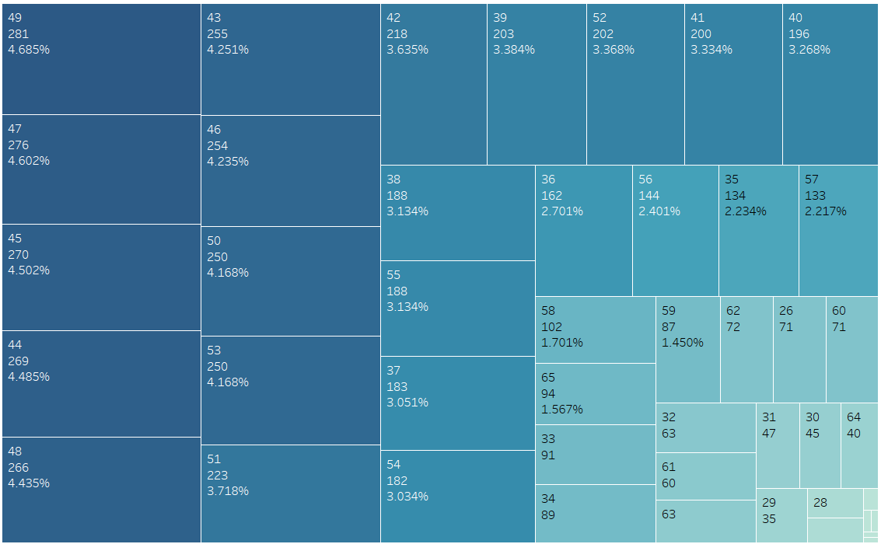
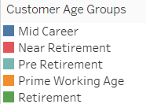
Customer Age Number of users in each Age
Monisha Vellore Dayananda

Slide 13
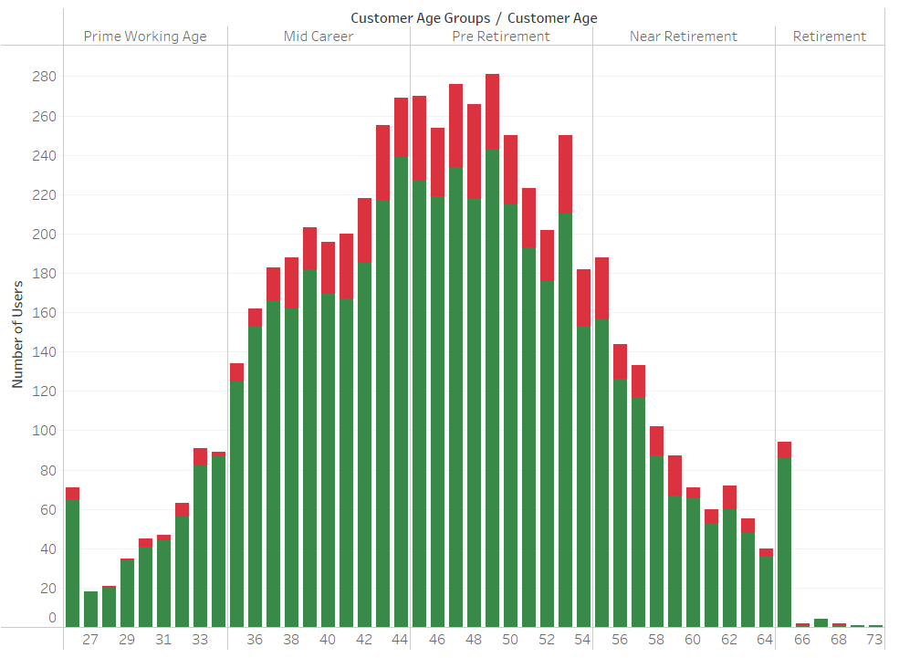
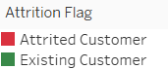
Customer Age Number of Churners & Non-Churners in each Age Group Category
Monisha Vellore Dayananda

Slide 14
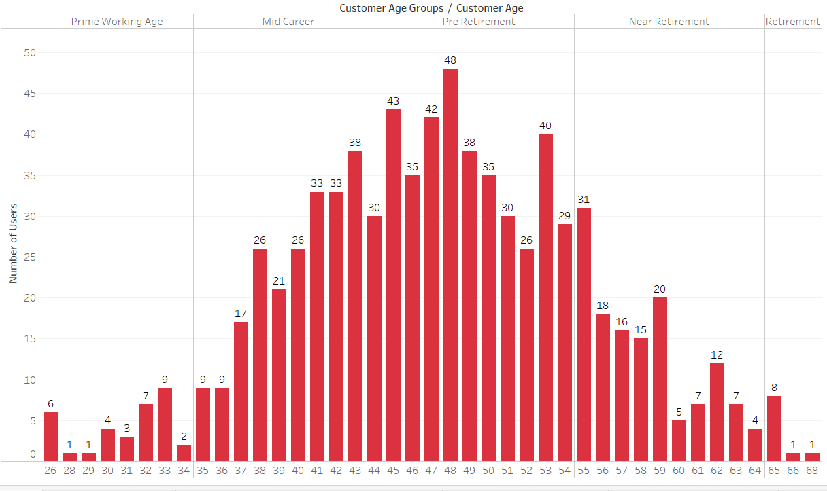
Customer Age Number of Churners in each Age Group Category
Monisha Vellore Dayananda

Slide 15
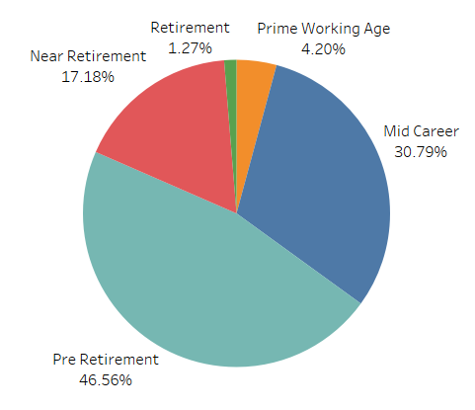
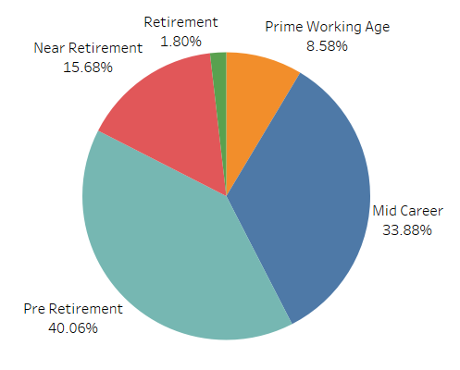
Customer Age Number of Churners & Non-Churners in each Age Group Category
Churners
Non-Churners
Monisha Vellore Dayananda

Slide 16

Income Category
Monisha Vellore Dayananda

Slide 17
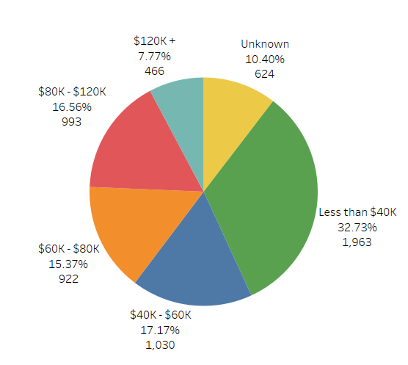
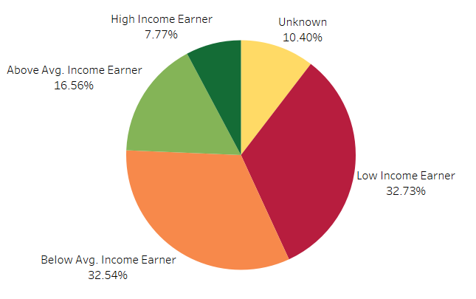
Income Category Number of users in each Income Category & Group
Income Category
Income Category Group
Monisha Vellore Dayananda

Slide 18
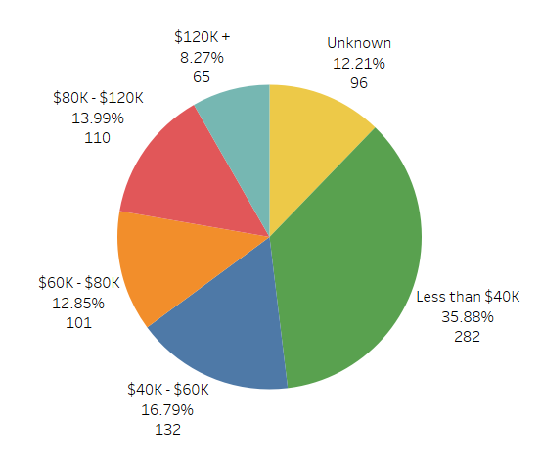
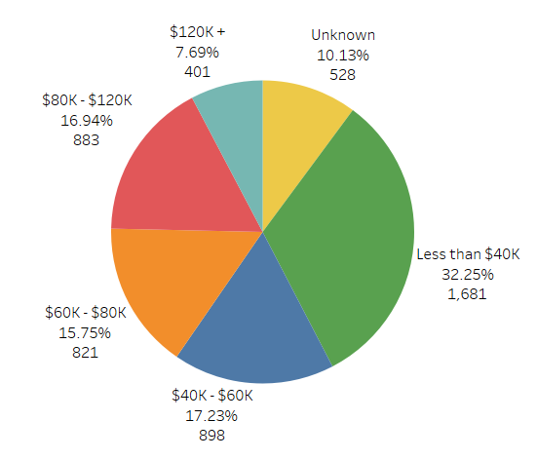
Income Category Number of Churners & Non-Churners in each Income Category
Churners
Non-Churners
Monisha Vellore Dayananda

Slide 19

Correlation Analysis

Slide 20
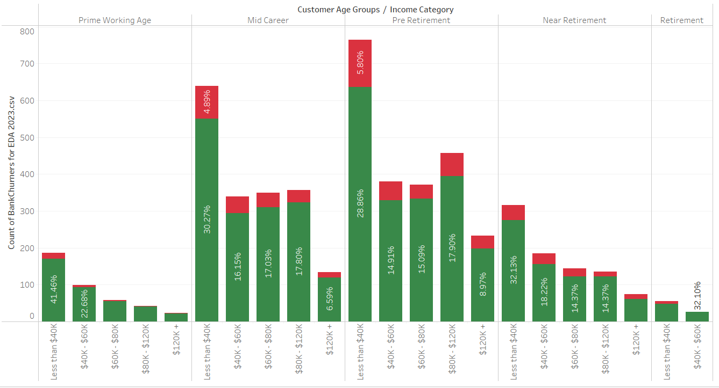
Correlation Analysis Number of Churners V/S Non Churners
Monisha Vellore Dayananda

Slide 21
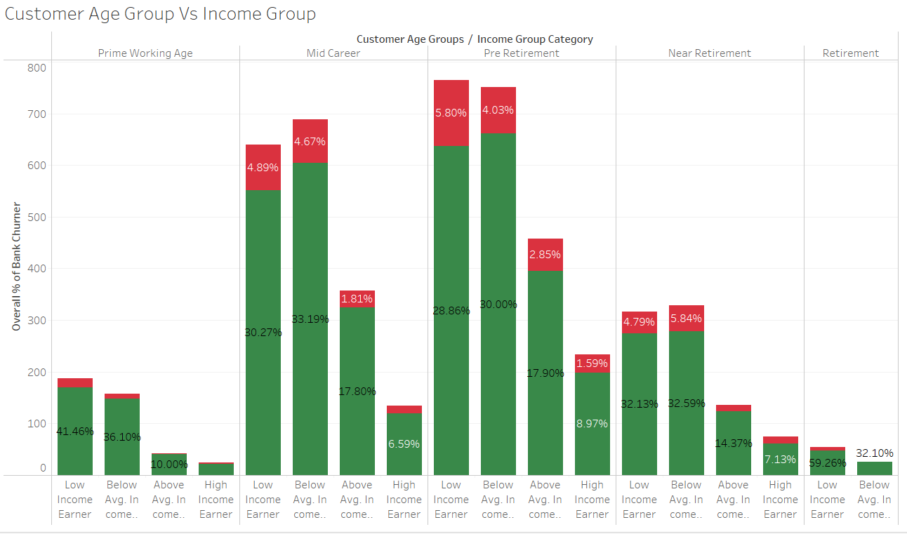
Correlation Analysis Number of Churners & Non-Churners in each Age Group Vs Income Category Group
Monisha Vellore Dayananda

Slide 22
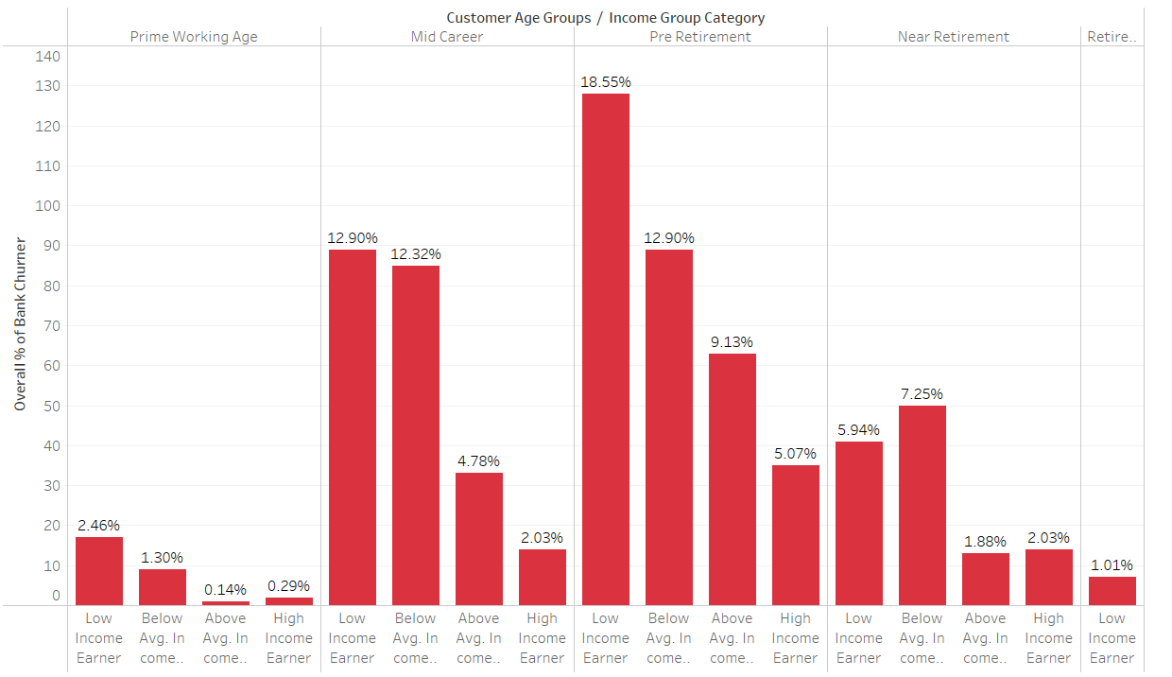
Correlation Analysis Number of Churners & Non-Churners in each Age Group Vs Income Category Group
Monisha Vellore Dayananda

Slide 23
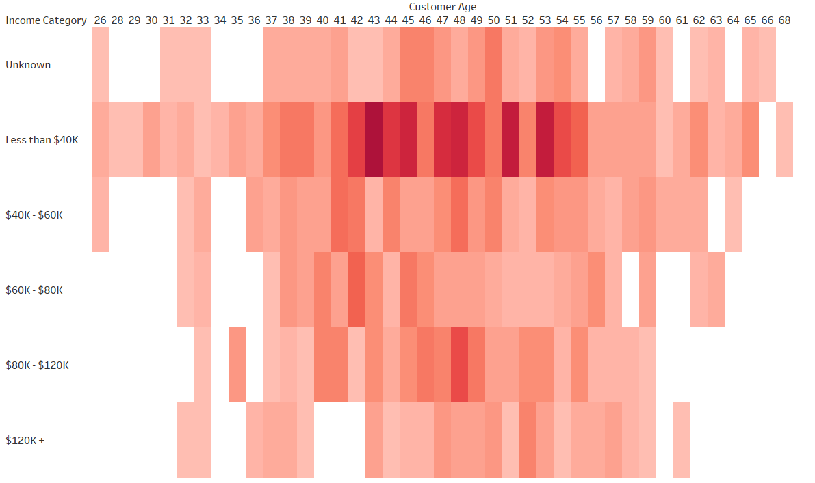
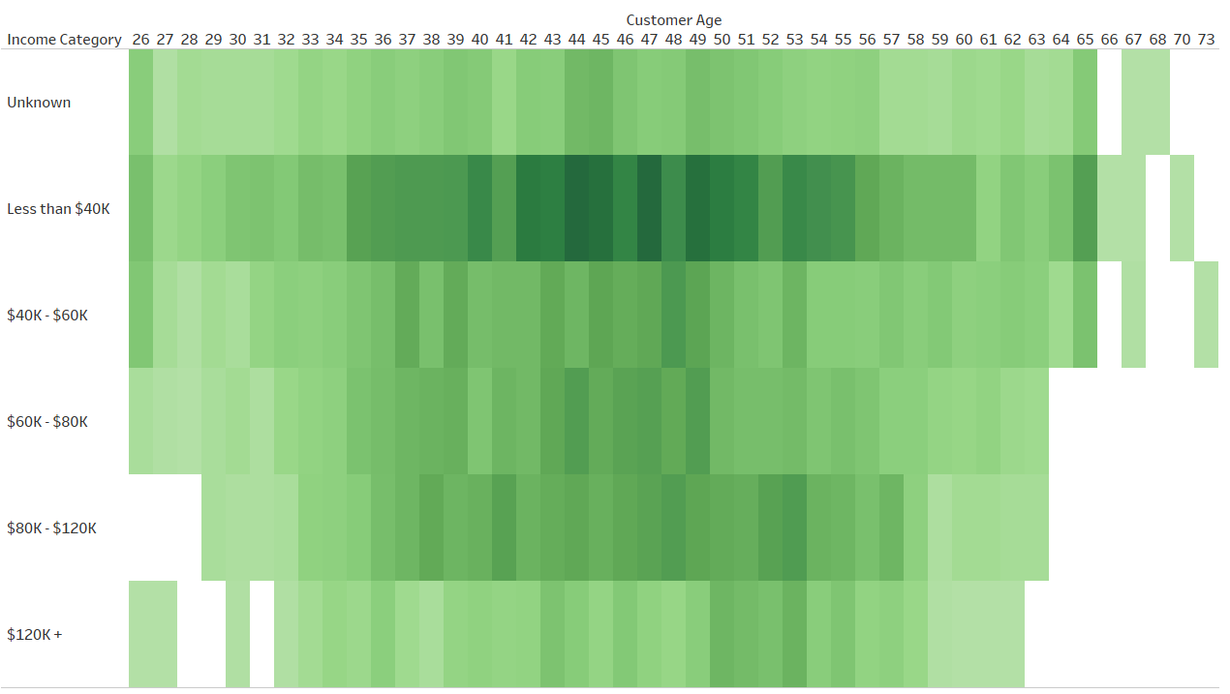
Correlation Analysis Number of Churners & Non-Churners in each Age Group Vs Income Category Group
Churners
Non-Churners
Monisha Vellore Dayananda

Slide 24

Total Transaction Count
Sejal Arora

Slide 25
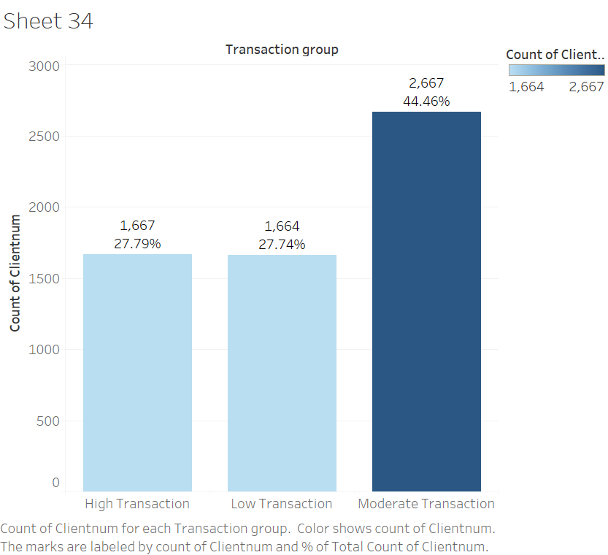
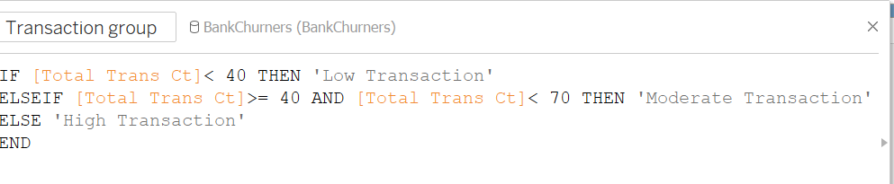
Total Transaction Count Number of people in each Total Transaction Count group

Slide 26
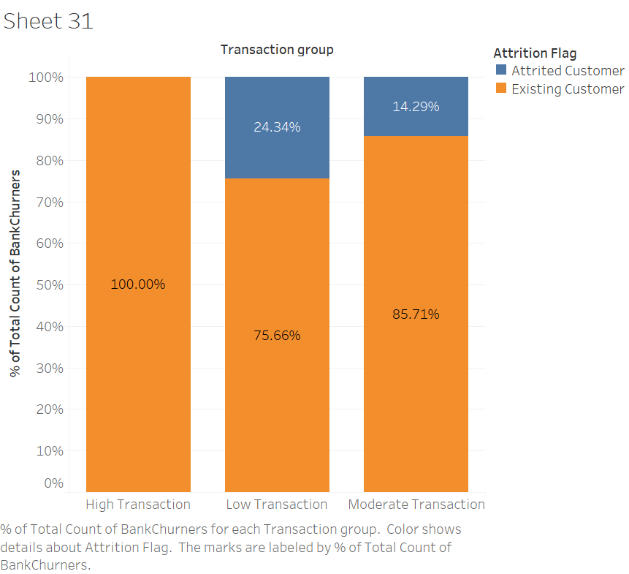
Total Transaction Count Percentage of Churners & Non-Churners in each Total Transaction Count group

Slide 27
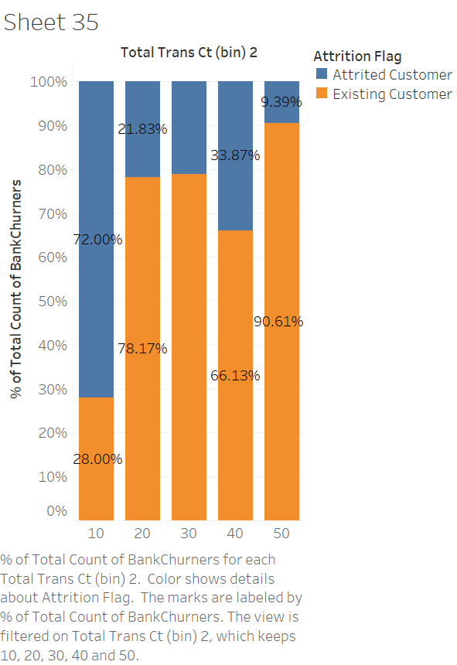
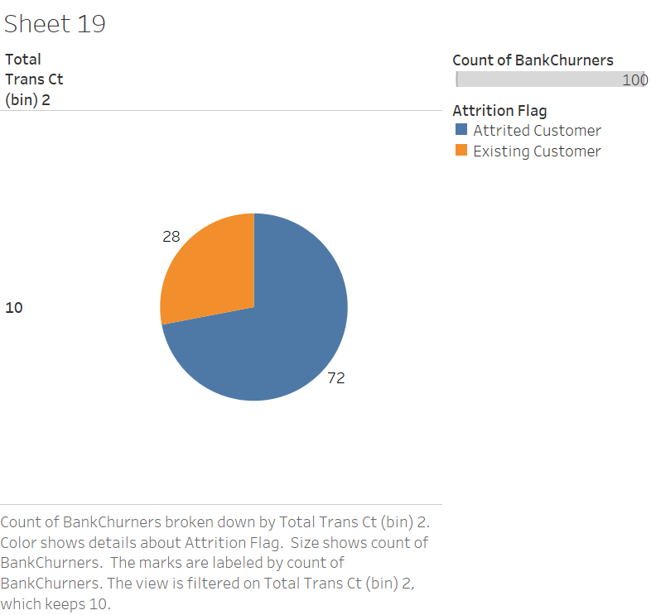
Total Transaction Count Percentage of Churners & Non-Churners in each Total Transaction Count bin

Slide 28
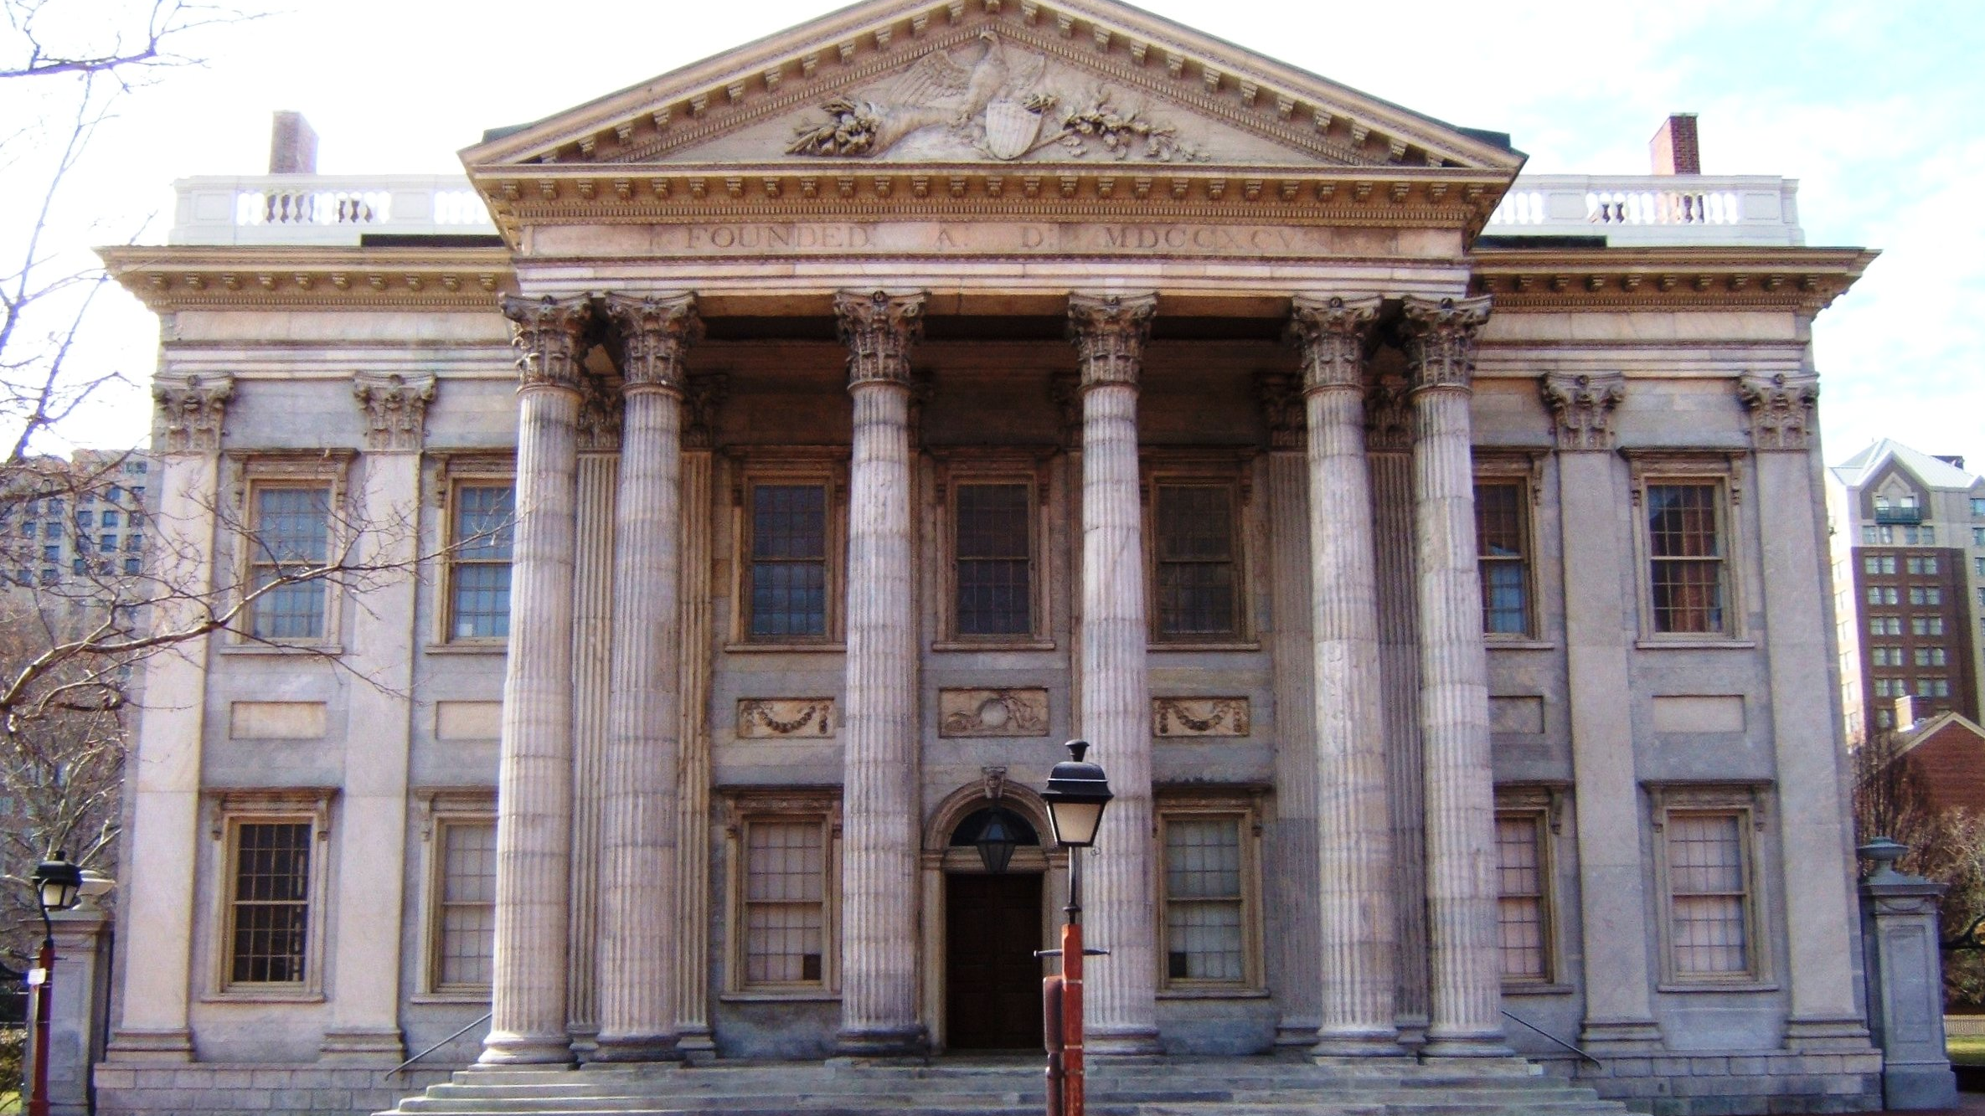
Total Relationship Count
Sejal Arora

Slide 29
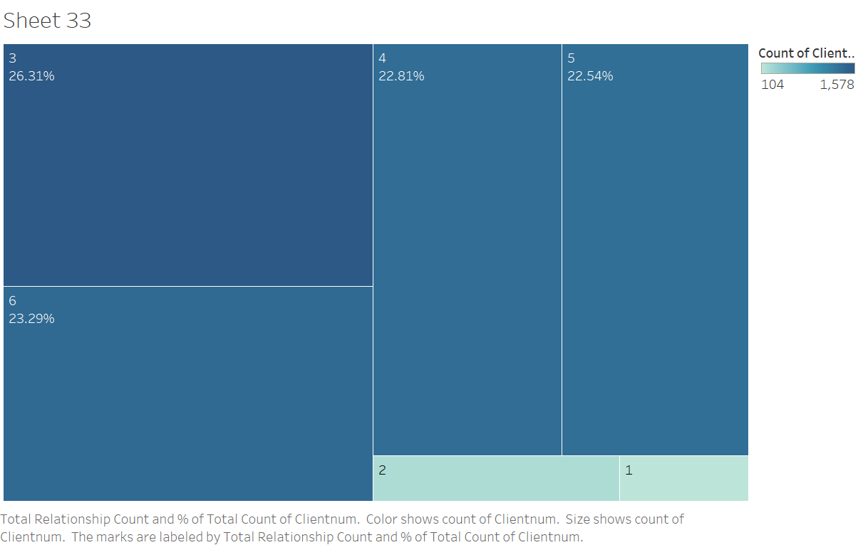
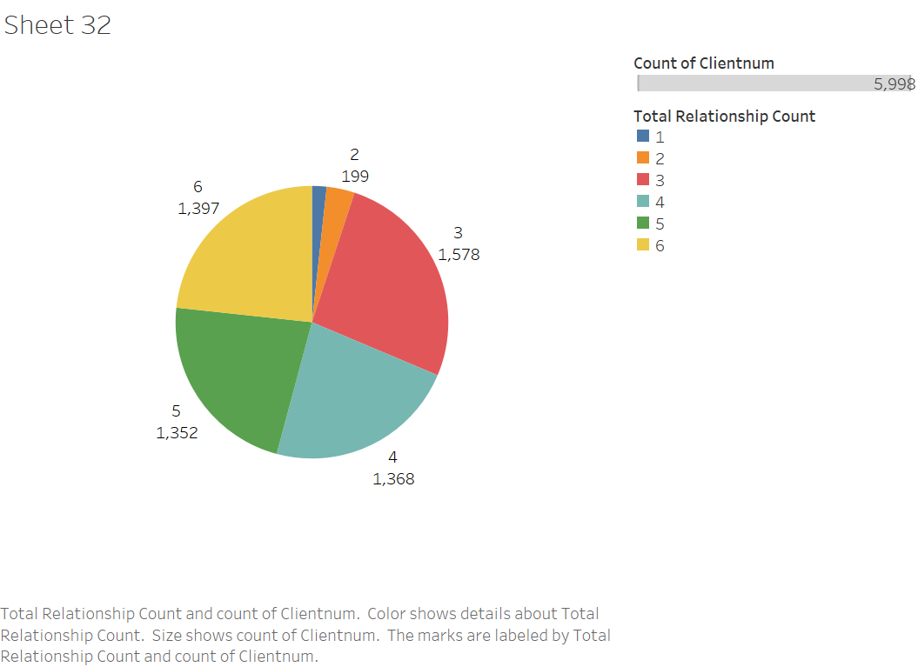
Total Relationship Count Number of users for each relationship count

Slide 30
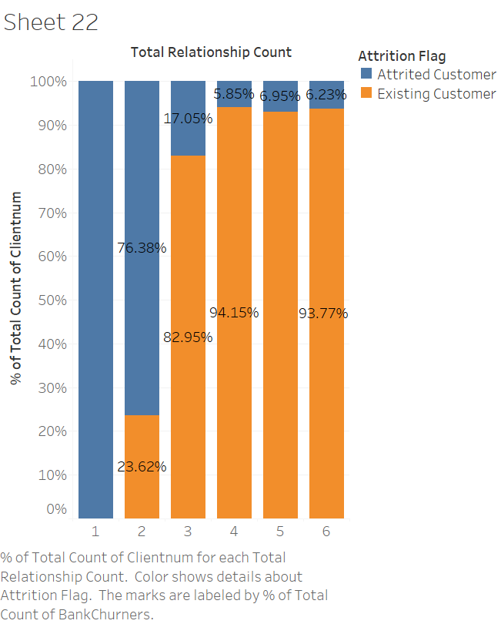
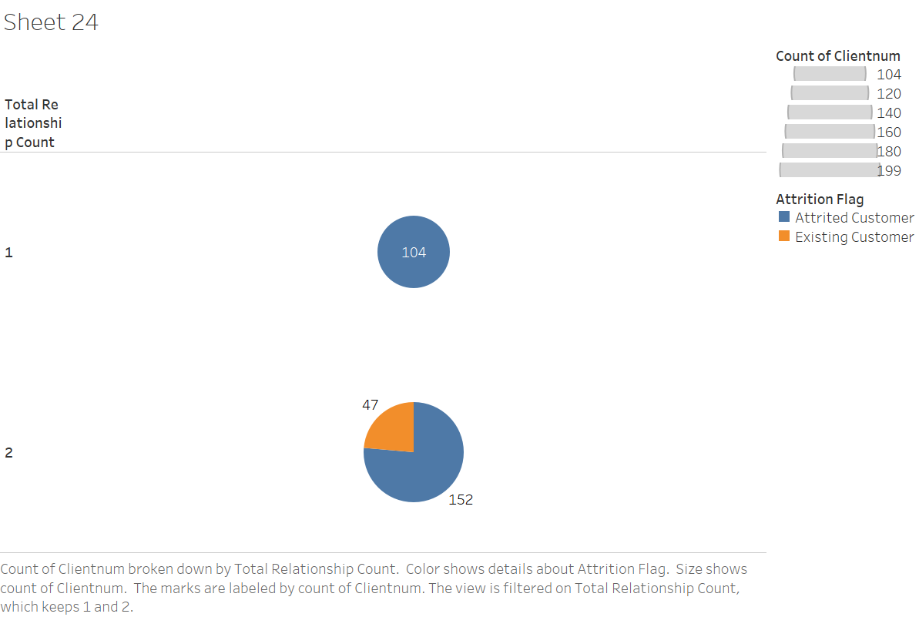
Total Relationship Count Percentage of Churners & Non-Churners in each Relationship count

Slide 31
CREDIT LIMIT
Saloni

Slide 32
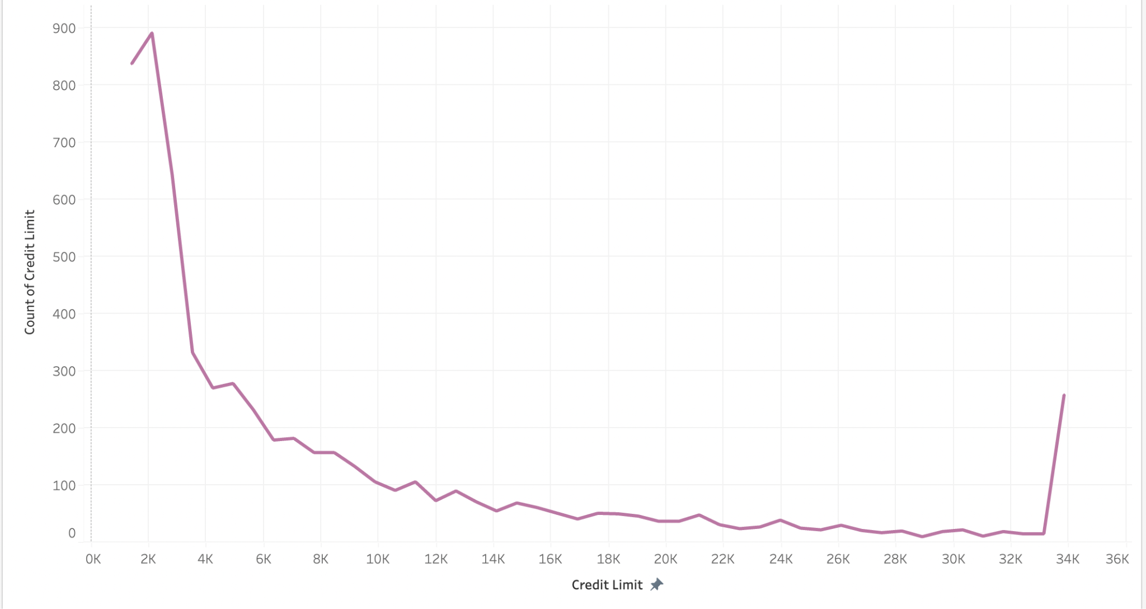

Slide 33
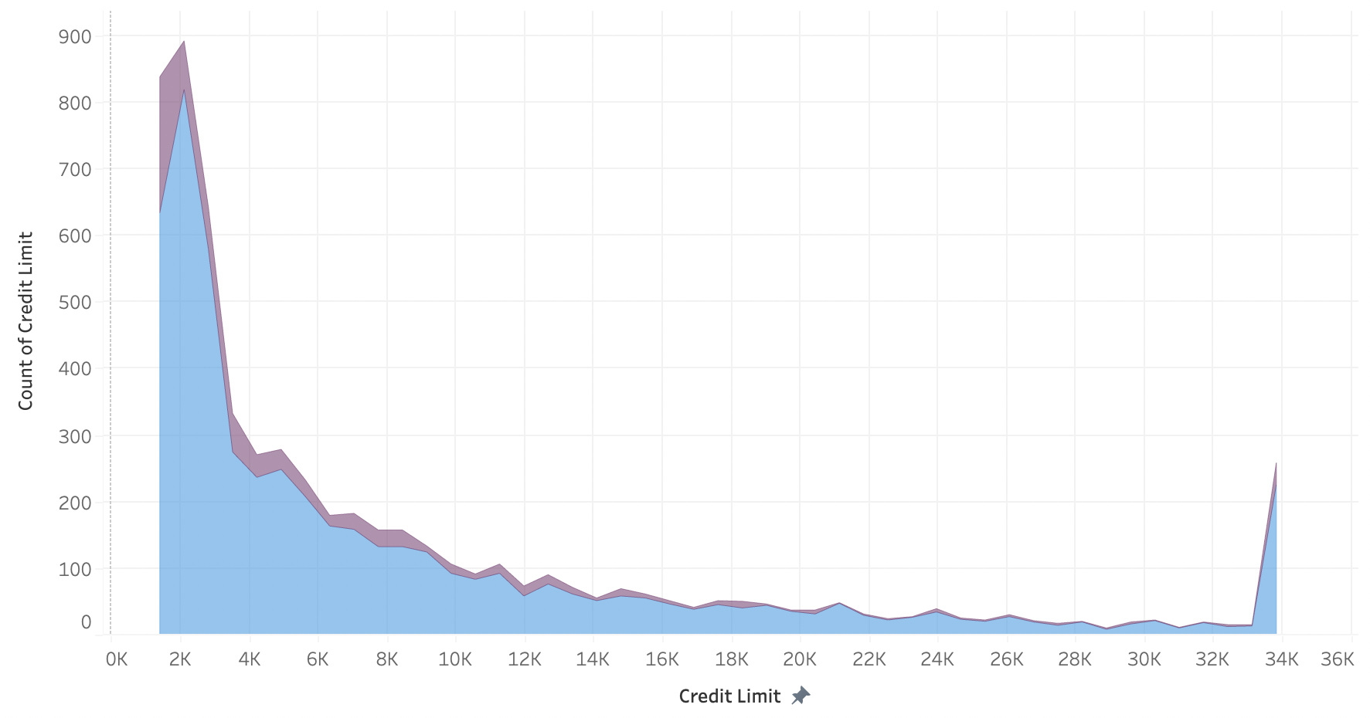
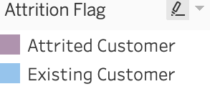
Number of Churner and Non-Churner for credit limit:

Slide 34
TOTAL TRANSACTION AMOUNT
Saloni

Slide 35
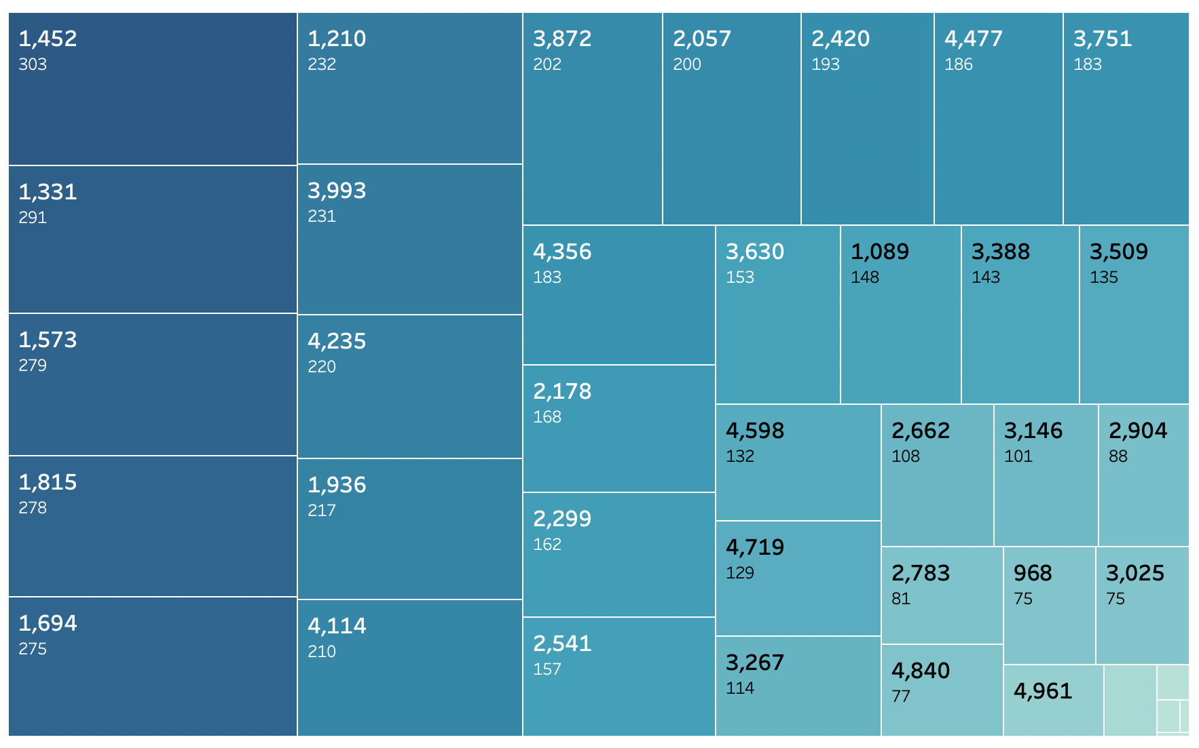
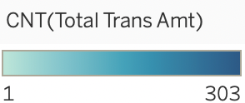

Slide 36
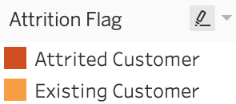
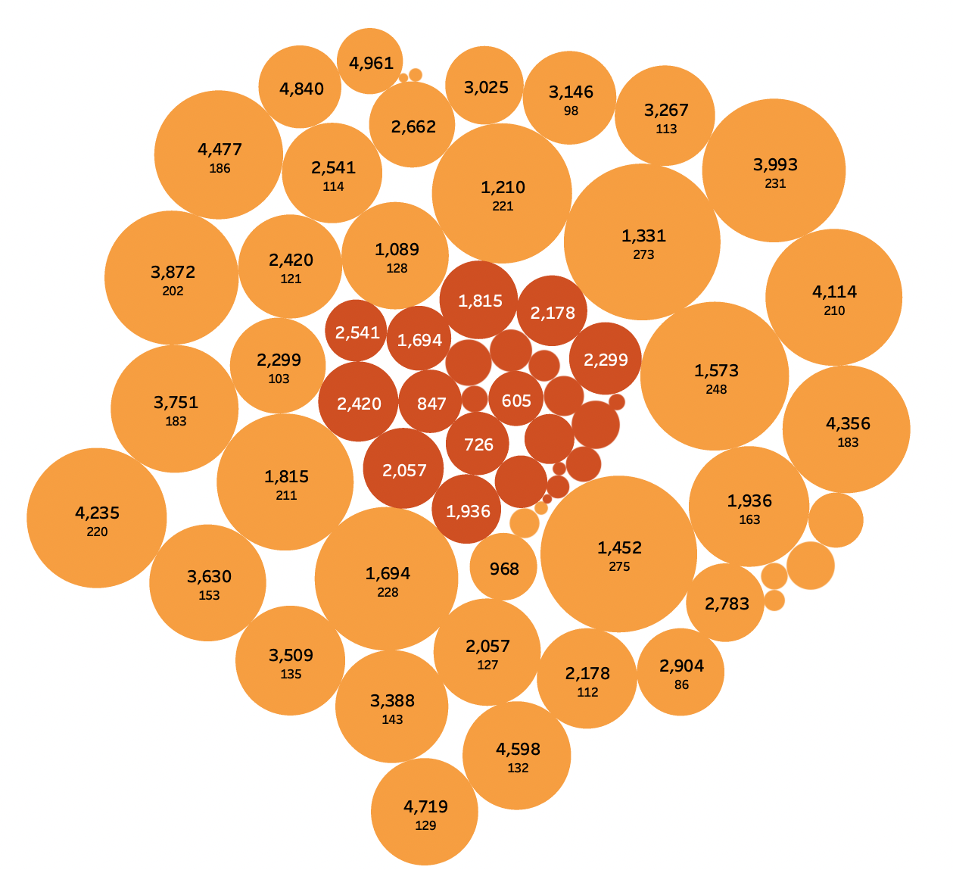
Number of Churner and Non-Churner for Total Transaction Amount:

Slide 37
CORRELATION ANALYSIS
Saloni

Slide 38
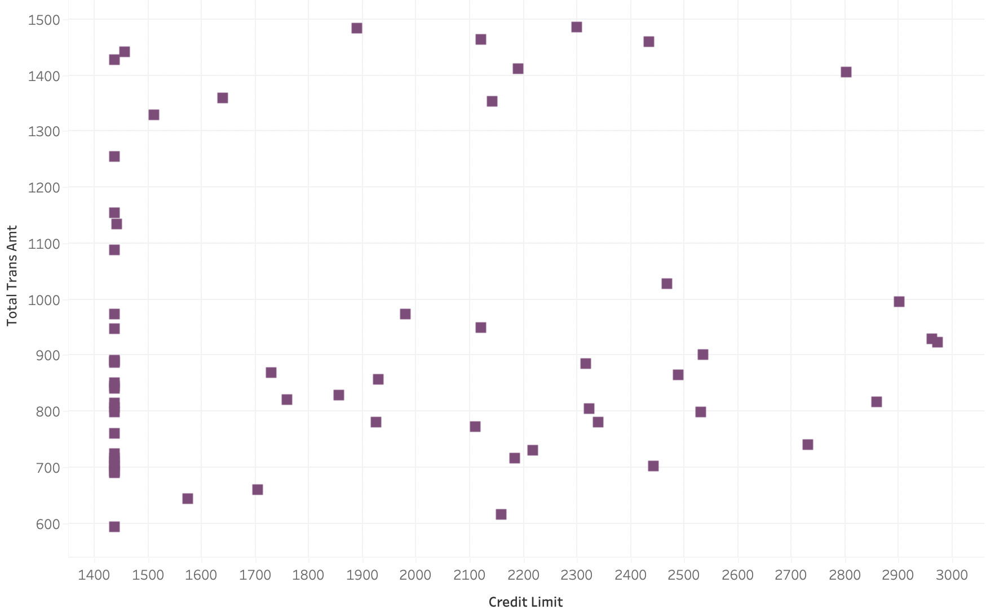
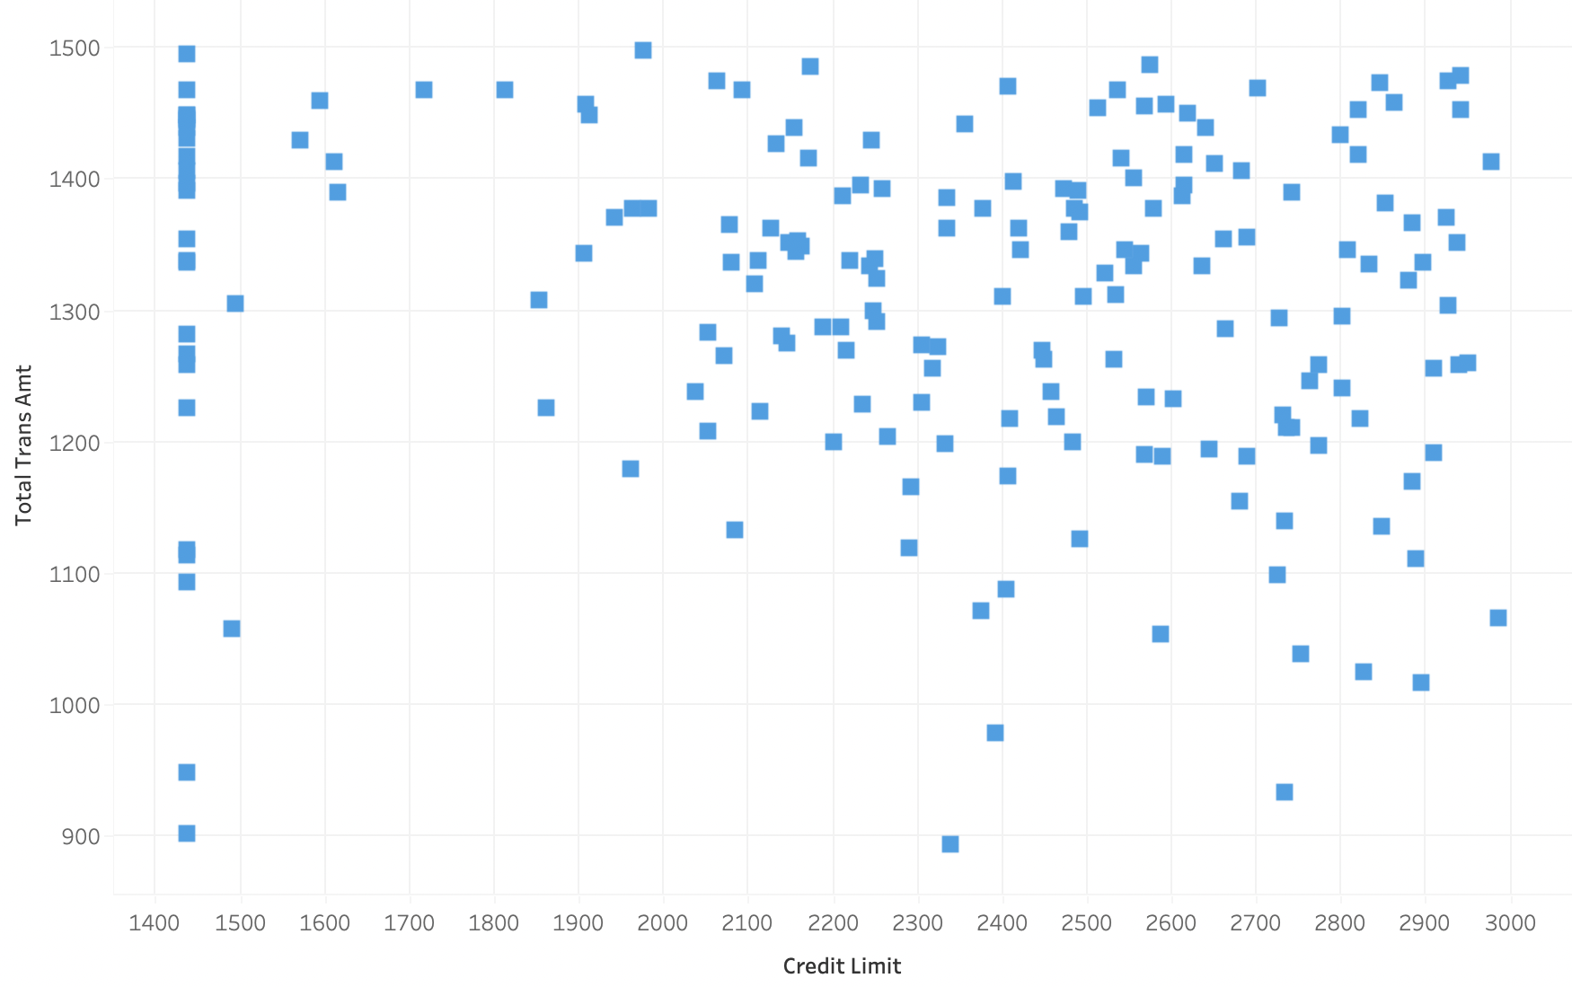
Number of Churners and Non-Churners in Credit Limit Vs Total Transaction Amount

Slide 39
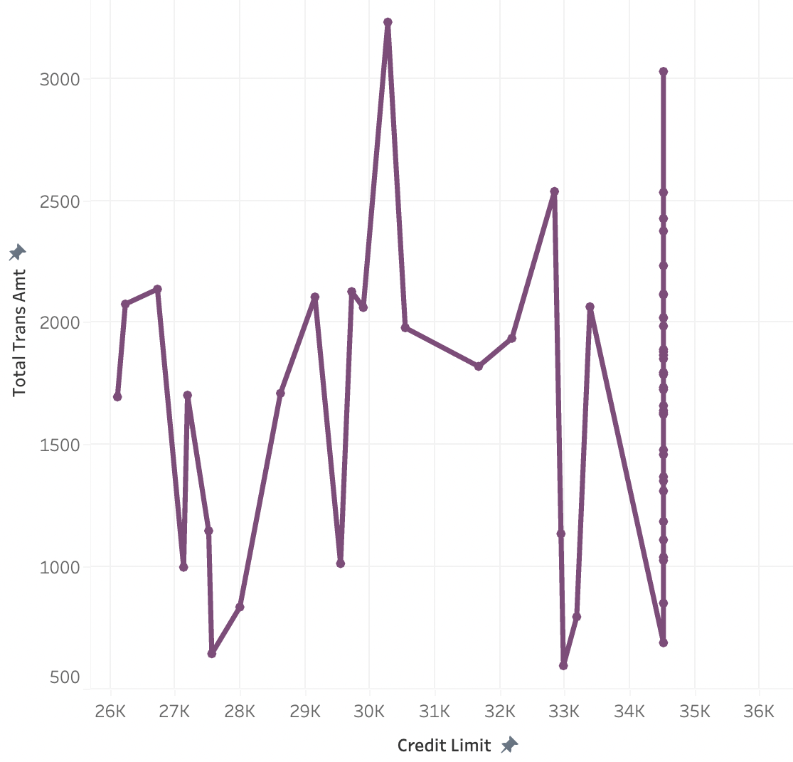
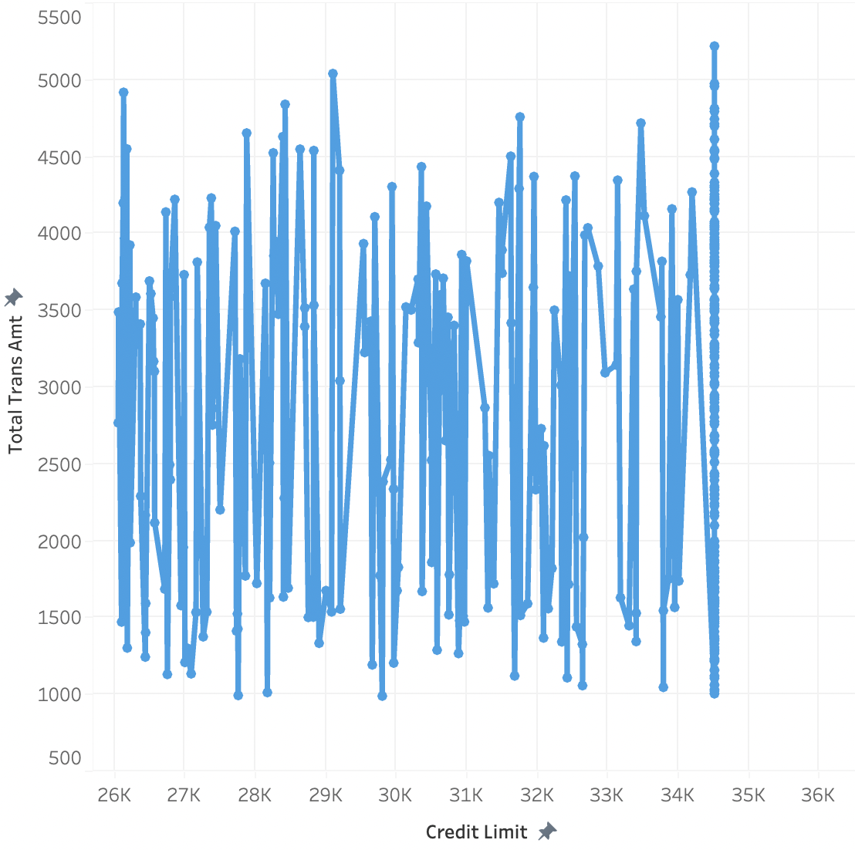
Churners Non-Churners

Slide 40

Average Utilization Ratio

Slide 41
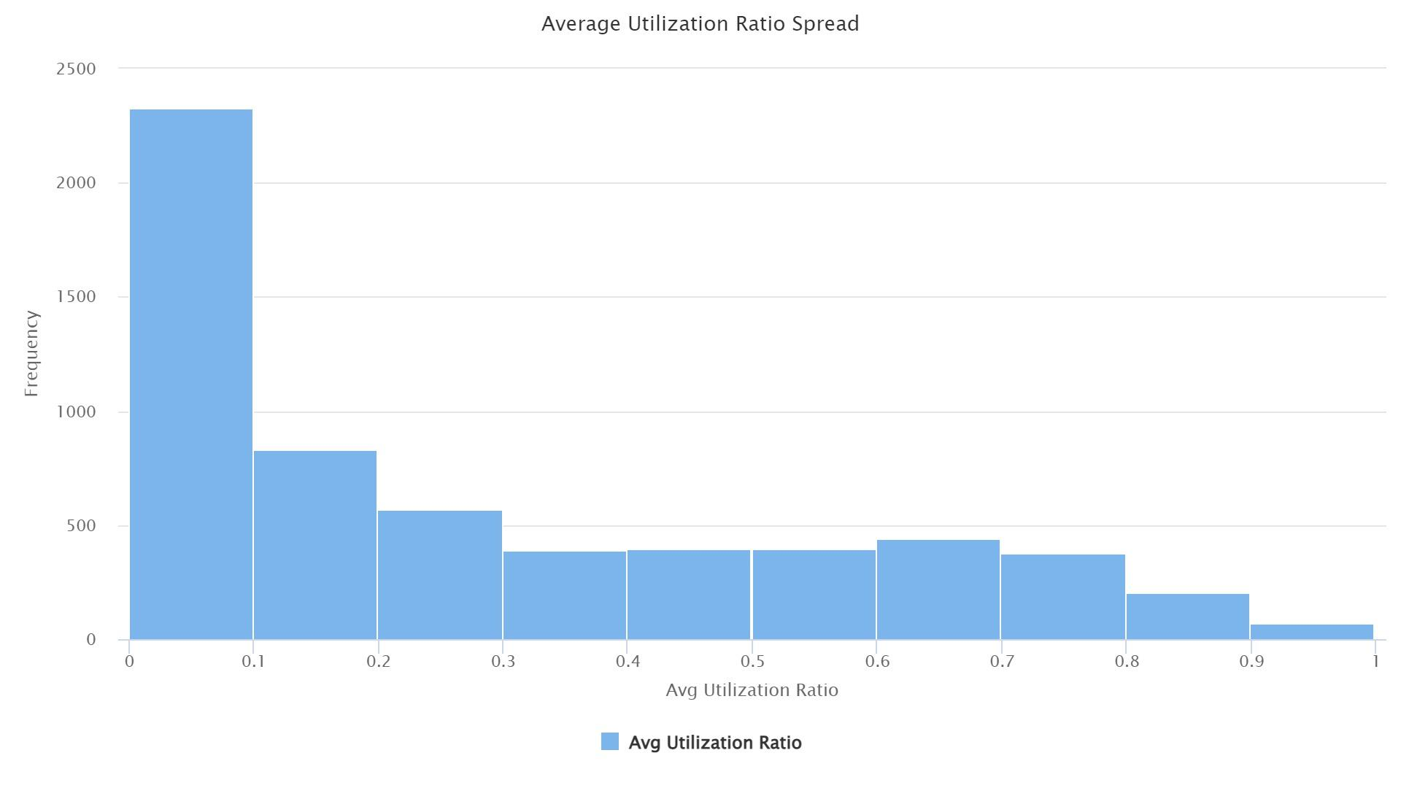
Average Utilization Ratio ratio of total credit limit used by the customer
Mean: 0.276
Frequent rate of 0, no credit usage
Right skew

Slide 42
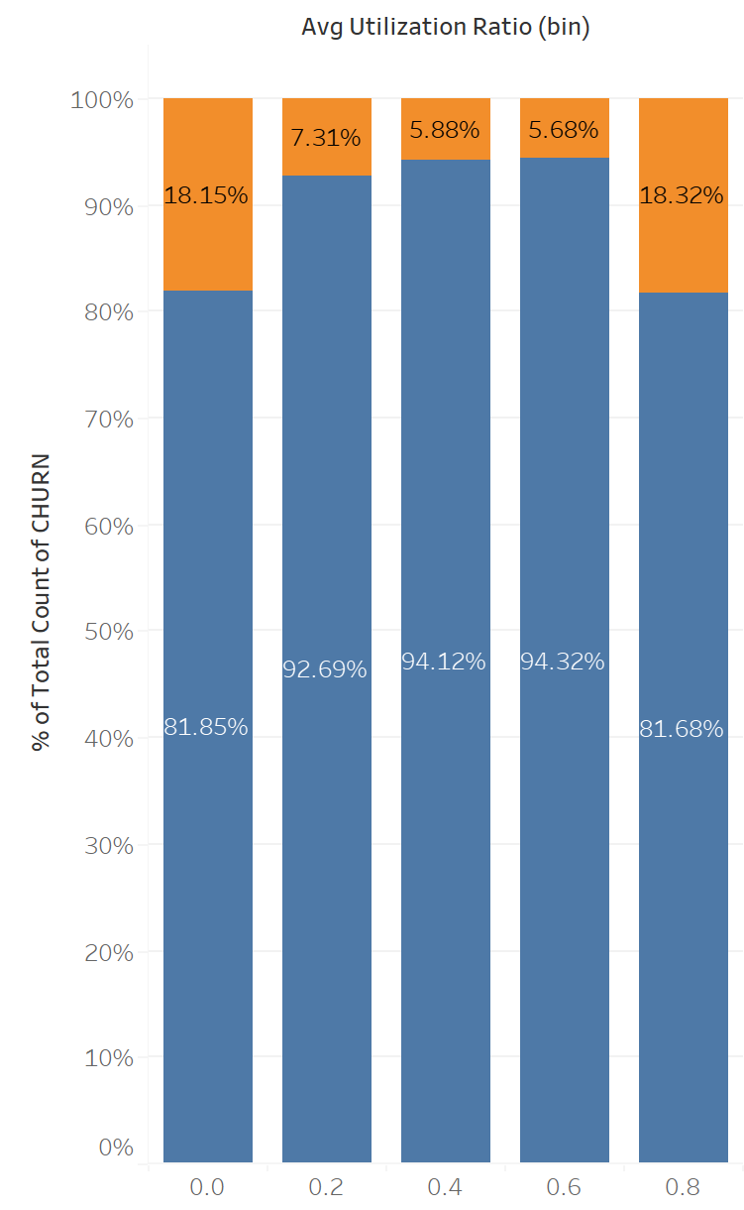
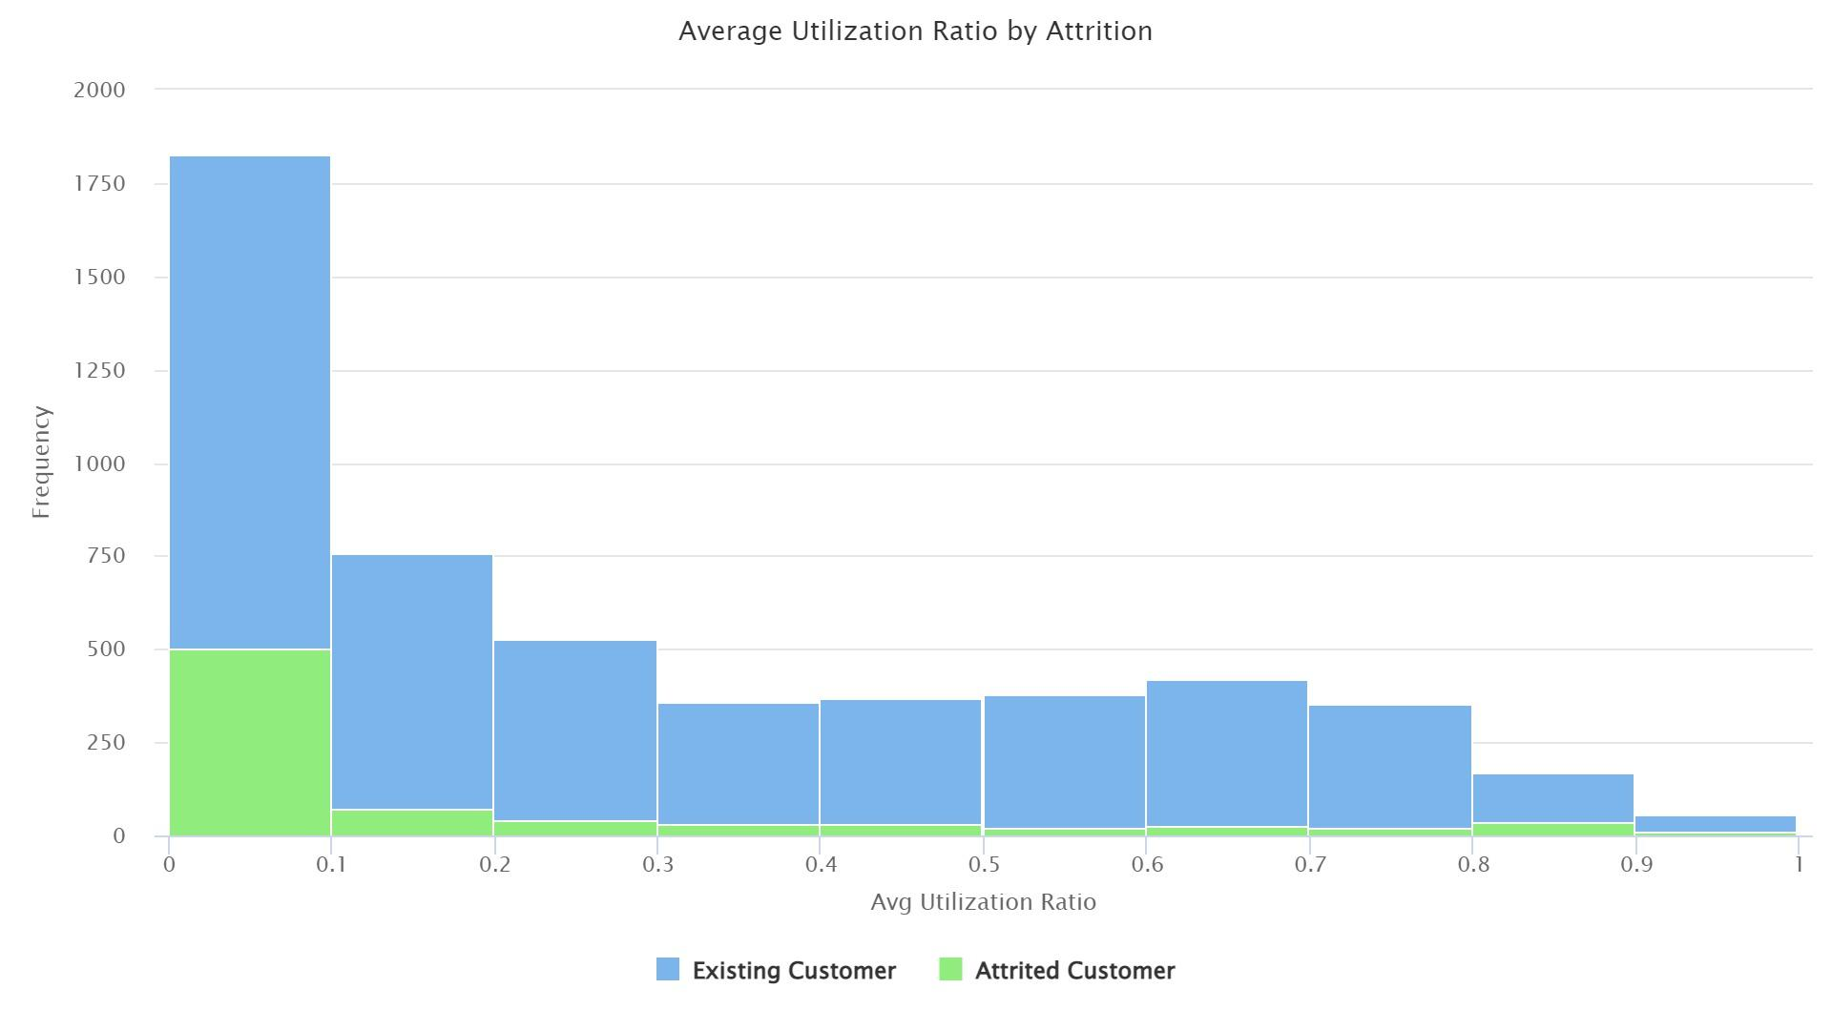
Util. Ratio & Attrition

Slide 43

Months on Book

Slide 44
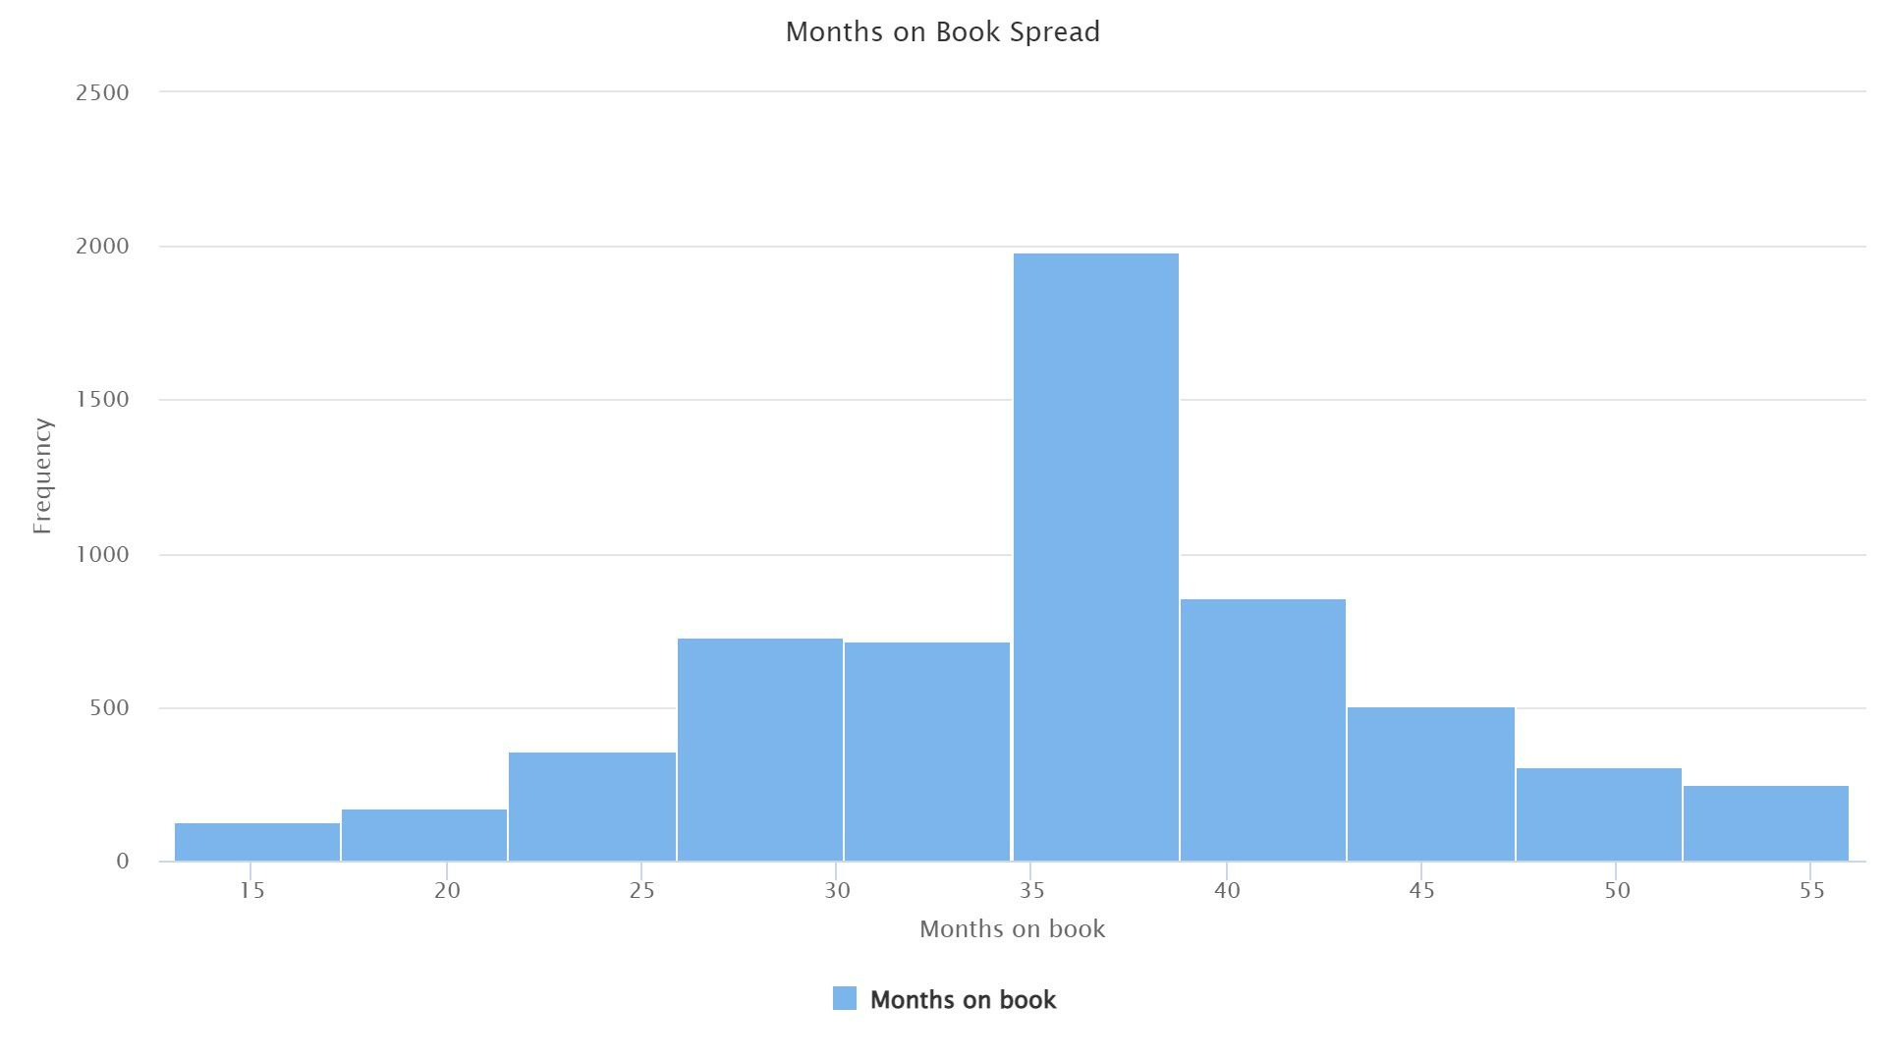
Months on Book Length of customer’s relationship with bank
Mean: 36 months
Highest frequency at 3 years

Slide 45
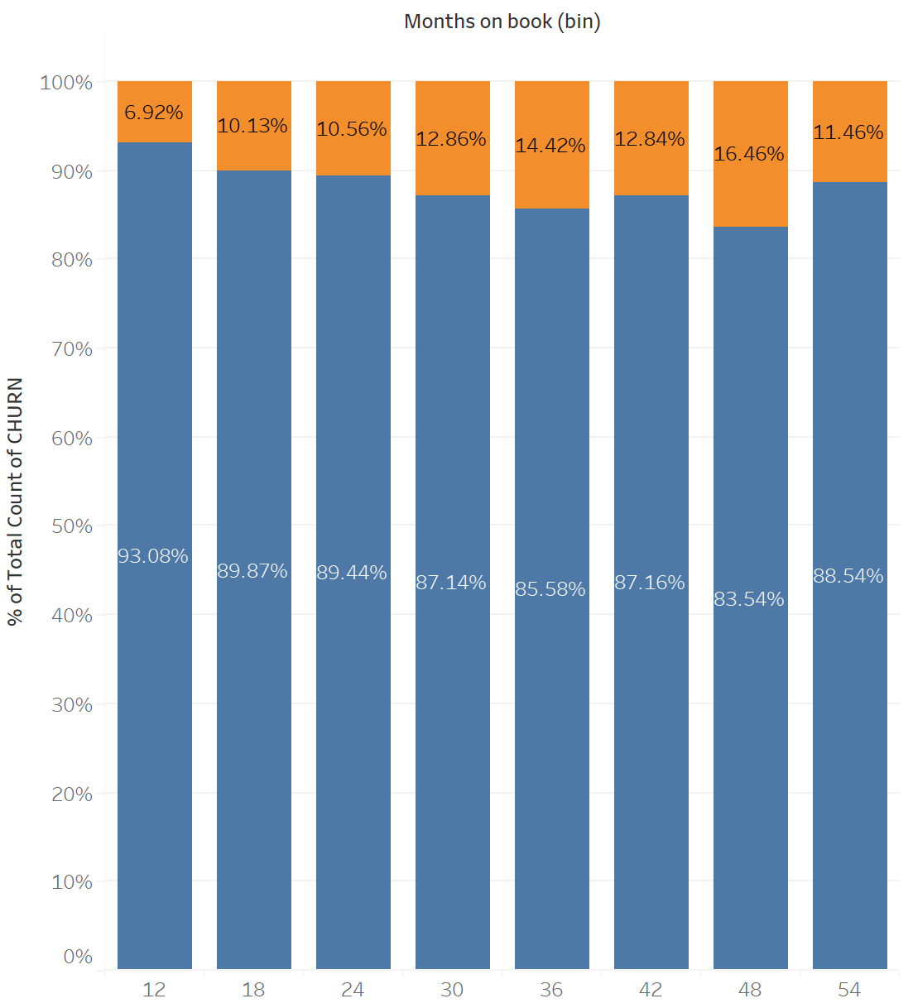

Months on Book & Attrition

Slide 46
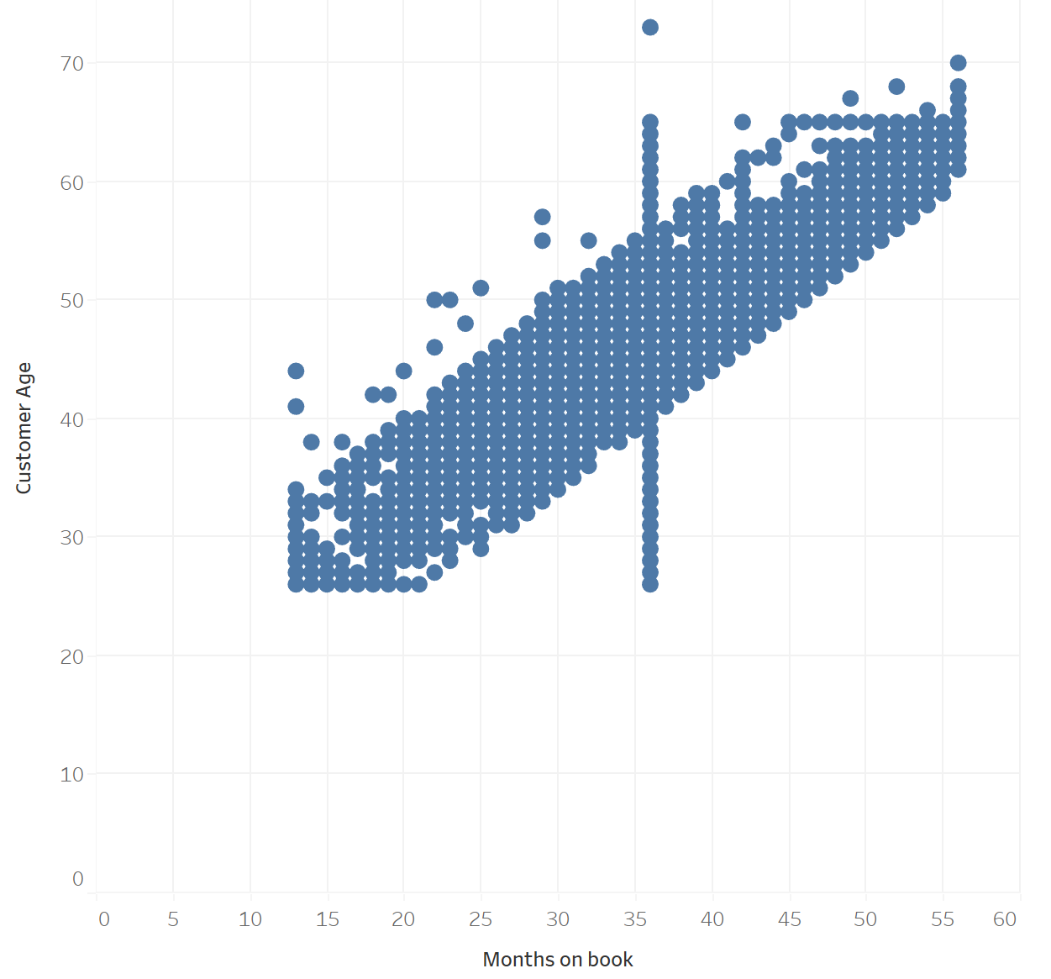
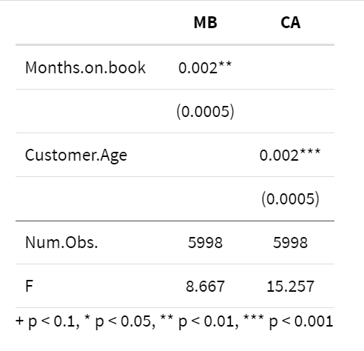
Correlation with Customer Age
Correlation: 0.805
R-Squared: 0.65

Slide 47
Three Machine Learning Models:
Logistics Model
Naive Bayes
Decision Tree
Logistic regression can handle binary outcomes and is straightforward to comprehend. A logistic function describes the link between independent factors and the likelihood of the dependent variable (churn) to forecast each customer's churn probability. Logistic regression may forecast bank churners by revealing behavior of customers and informing retention and performance measures.
Naive Bayes is a powerful tool for predicting bank churners because it can provide insights into customer behavior and inform strategies for retaining customers and improving business performance. It can also be useful for identifying the most important variables that contribute to churn and developing targeted retention strategies.
The decision tree method divides data recursively by the most informative variable at each stage. Splitting the tree develops additional branches until a halting requirement is fulfilled (e.g. a minimum number of observations in each leaf node). They manage complicated variable connections and are straightforward to read.

Slide 48

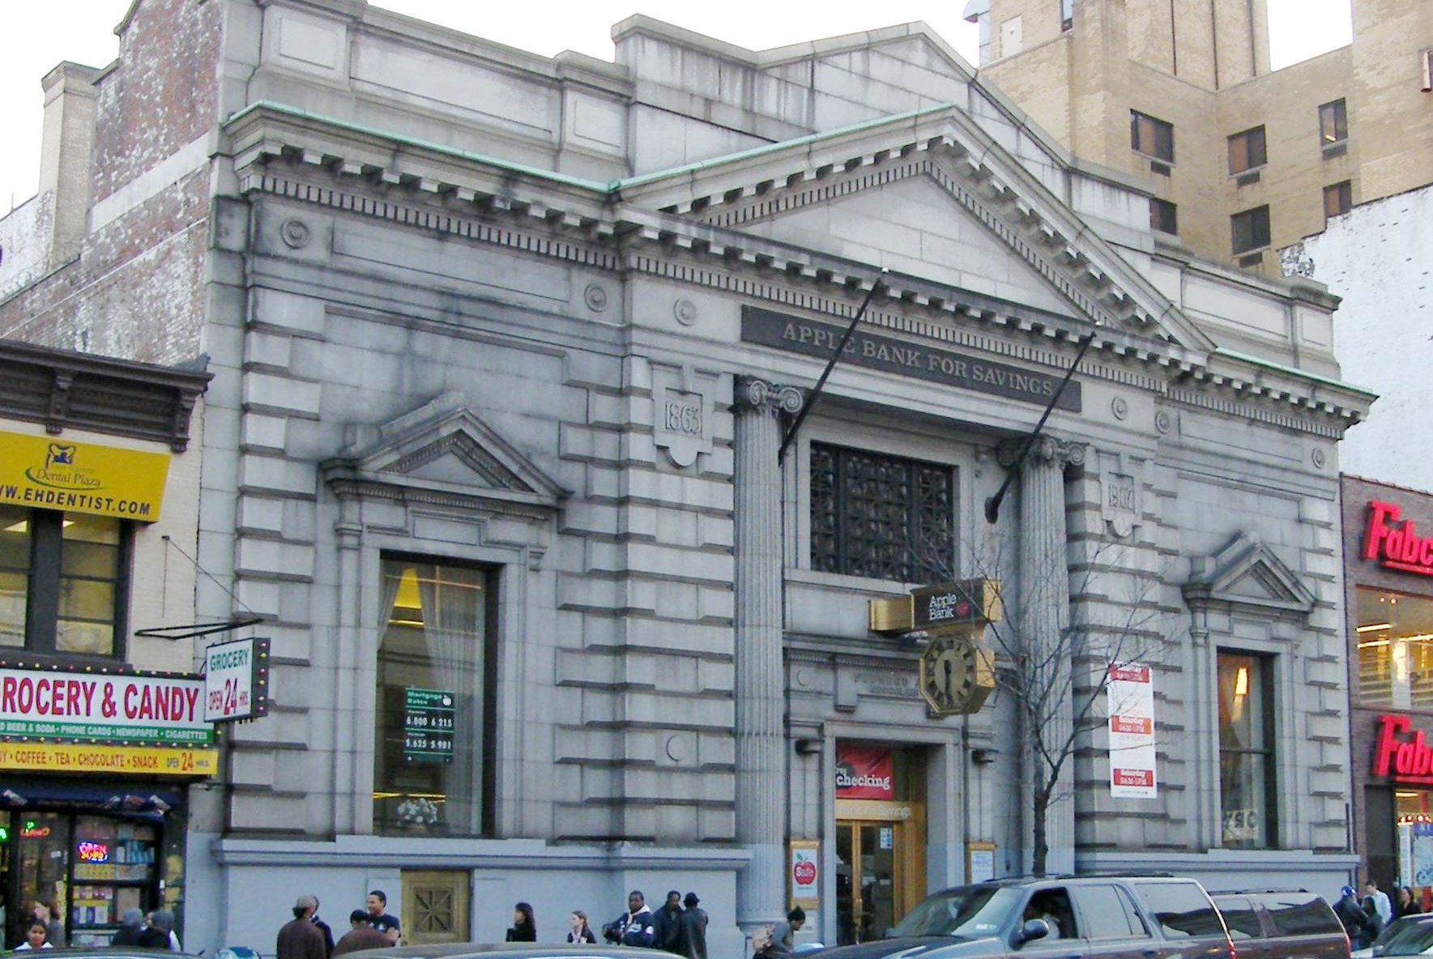
Conclusion
Age and income category predictor variables are easy to collect and it improves our churn prediction model to help banks retain customers.
Customers with low Total transaction count and Total relationship count are more likely to churn.
The Average Utilization Ratio is beneficial for our model, but we may omit months on book due to its correlation with age
To summarize, both credit limit and transaction amount have a significant impact on bank churn. Customers with low credit limits or fewer transactions are more likely to churn, while high credit limit customers who are not utilizing their credit card can also be at risk.

Slide 49
THANK YOU

